Slide 1
SECURE DATA HIDING IN IMAGES USING STEGANOGRAPHY
CAPSTONE PROJECT
Presented By: BOLLA THARUN
Student Name: BOLLA THARUN
College Name: SR University
Department : MCA

Slide 2
OUTLINE
Problem Statement
Technology used
Wow factor
End users
Result
Conclusion
Git-hub Link
Future scope

Slide 3
PROBLEM STATEMENT
Traditional encryption methods are easily detectable and can raise suspicion.
Need for a secure way to hide confidential messages within images.
Ensuring data security while maintaining the integrity of the cover image.
Making encryption and decryption accessible to non-technical users through a simple interface.

Slide 4
TECHNOLOGY USED
Programming Language: Python
Image Processing Library: OpenCV(for image read/write operations)
File Handling & Security: Basic encryption logic for password protection
Device Specifications:
RAM: 16 GB
Processor: Intel(R) Core(TM)i5-9300H CPU @ 2.40 GHz
Platform: Windows 11

Slide 5
WOW FACTORS
1.Password Authentication: Requires a password to encrypt/decrypt,adding a security.
2.NULL Byte Termination: Uses \0 as an end marker for precise message extraction.
3.Error Handling: Checks message length against image capacity to avoid data loss.
4.Pixel-Level Encryption:Embeds data directly into RGB channels without altering visual quality.
5.Lightweight & Simple:Minimal dependencies (only OpenCV) for easy setup and execution.
6.Cross-Compatibility:Encrypted output is a standard PNG file,ensuring portability.

Slide 6
END USERS
Cybersecurity Enthusiasts – Exploring secure communication techniques.
Government & Defense – Secure message transmission without raising suspicion.
Journalists & Activists – Concealing sensitive information in images to avoid surveillance.
Software Developers – Learning steganography concepts and their applications.

Slide 7
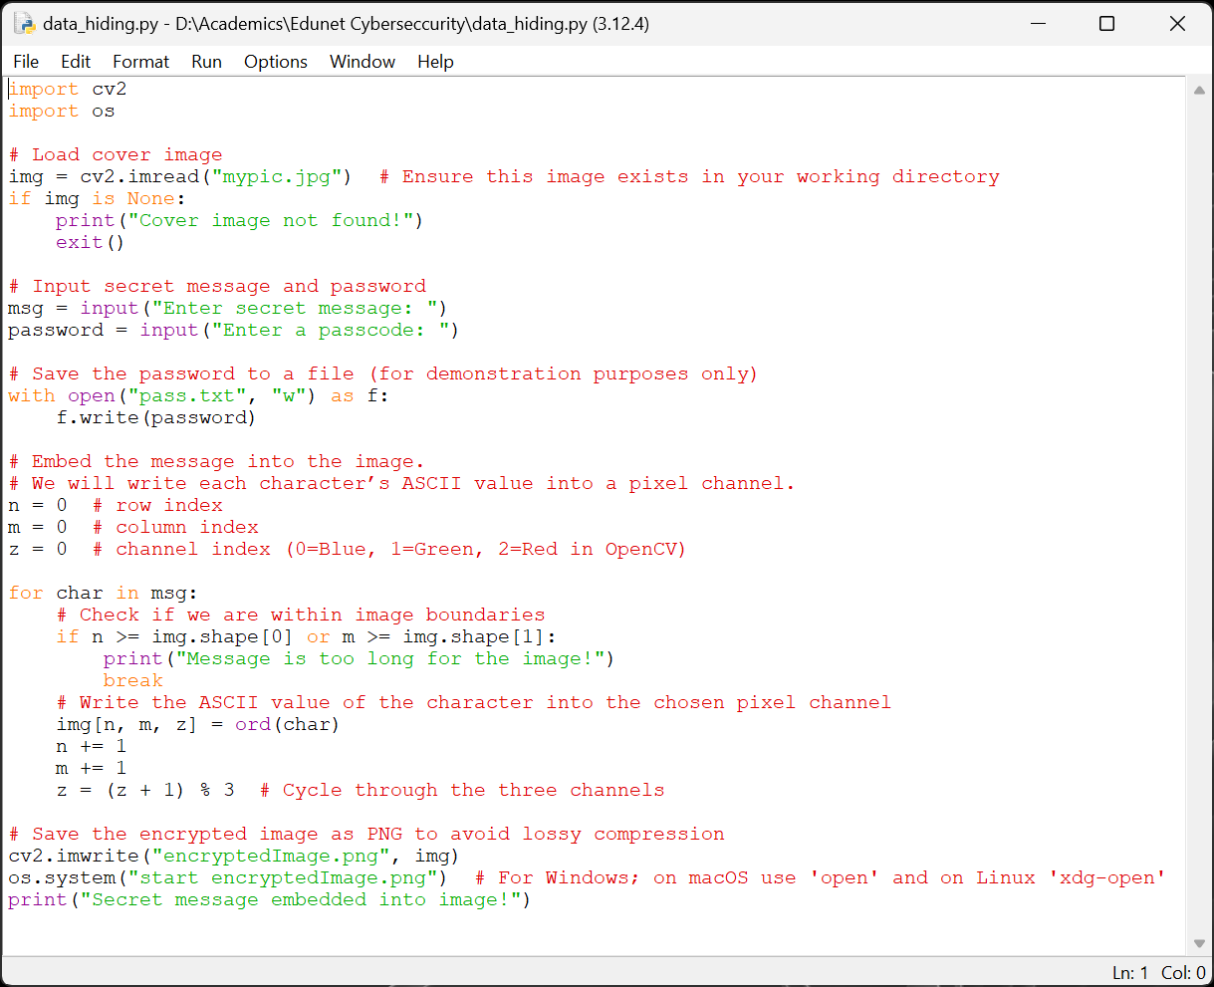
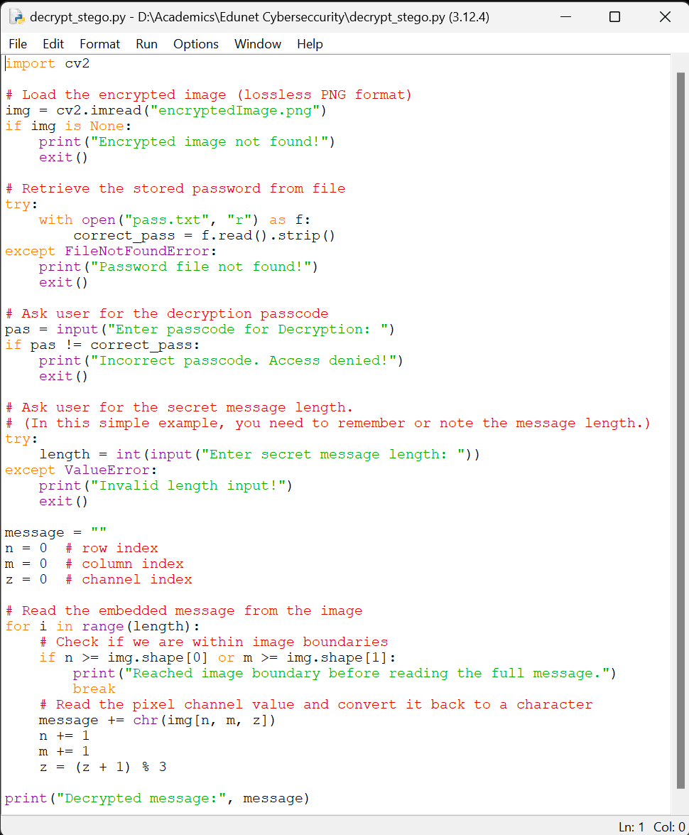
RESULTS
Encryption Code:
Decryption Code :

Slide 8
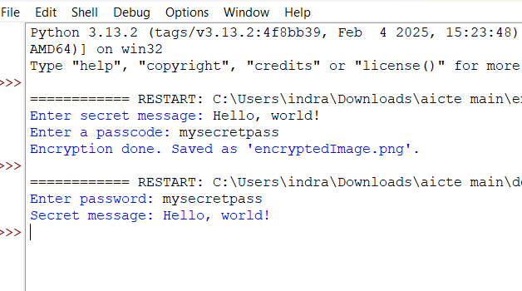
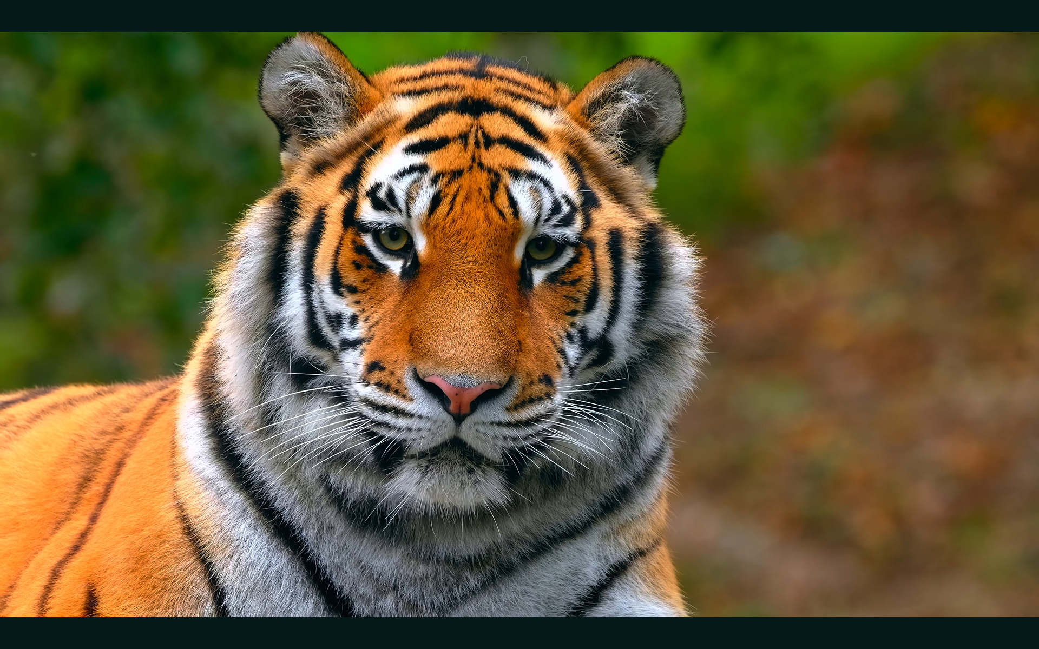
Input /output
Input Image File:
output Image File:

Slide 9
CONCLUSION
Steganography provides a covert way of communicating sensitive information.
This project showcases a simple yet effective implementation of message hiding in images.
Future improvements can make it more robust, secure, and scalable.
Uses pixel-level RGB channel manipulation to conceal messages without visibly altering the image.
Built with a single dependency(OpenCV),prioritizing simplicity and ease of use across systems.
Outputs encrypted data as a standard PNG file , ensuring seamless sharing and cross-platform access.
Combines steganography with lightweight encryption , offering a user-friendly yet secure solution for real-world data hiding.

Slide 10
GITHUB LINK
https://github.com/BollaTharun/steganography.git

Slide 11
FUTURE SCOPE
Advanced Encryption Techniques – Integrate AES encryption before embedding text in images.
Support for Audio & Video Steganography – Expanding beyond images.
AI-based Detection Prevention – Ensuring messages stay undetectable from modern forensic tools.
Mobile App & Web Version – Expanding accessibility beyond desktops.
Multi-Layer Security – Combining steganography with blockchain for ultra-secure communication.

Slide 12
THANK YOU

